Slide 1
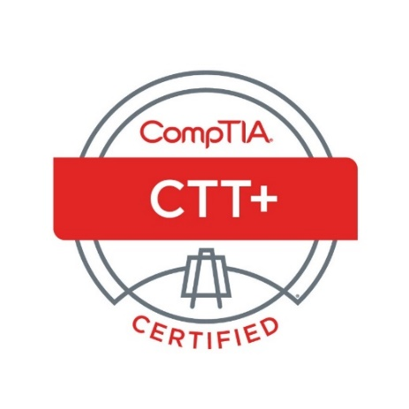

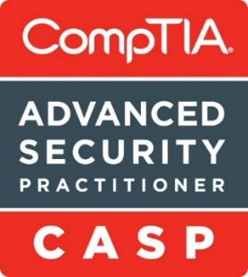

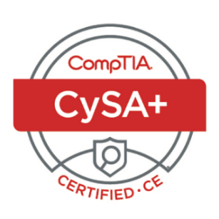
USDC IT CoE: Security+
Introductory Session
CompTIA Security+
Test: SYO-601
6-Week Training Class
Trainer: Jim Reeves

Slide 2
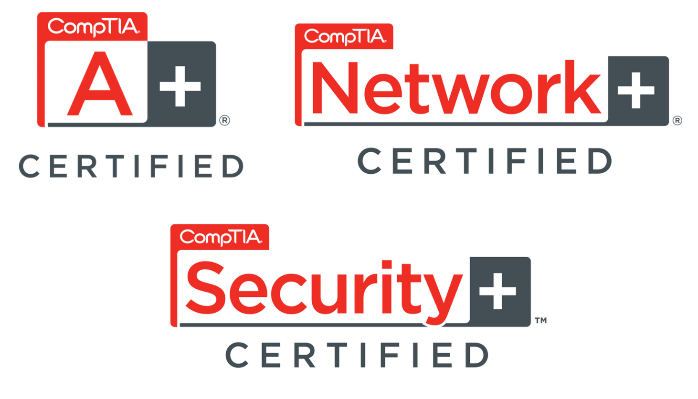
Security+
Recommended Prerequisites / Understanding

Slide 3
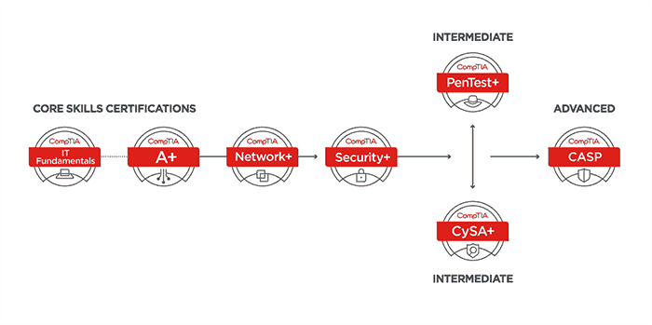
Security+
CompTIA Certifications Path

Slide 4
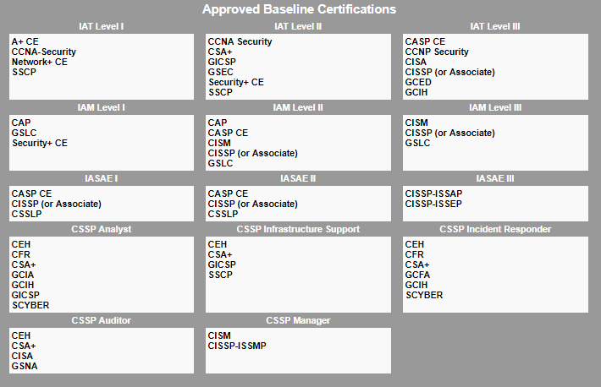
US Government Department of Defense Requirements
Security+
https://public.cyber.mil/cw/cwmp/dod-approved-8570-baseline-certifications/

Slide 5
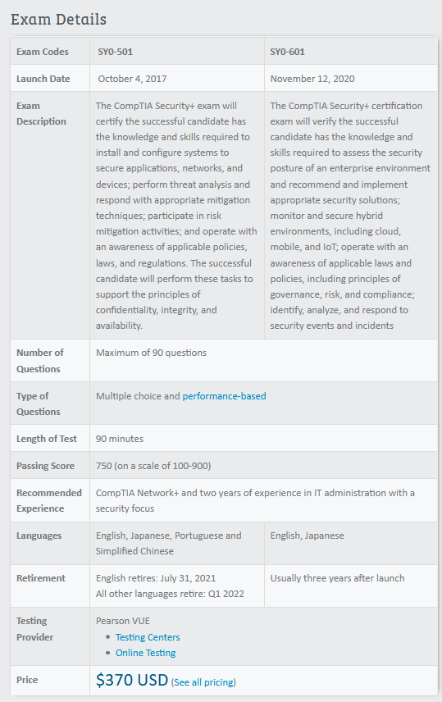
EXAM DETAILS
Security+
The course materials for these sessions are based on the SYS-601 materials.
Information on the Security+ Exam found at:
www.comptia.org
Note:
The passing score for the test is 750 out of possible 900.
This is a high passing score with equates to:
750/900 = 83 %

Slide 6
EXAM VOUCHER REQUIREMENTS
Security+
Deloitte will provide a voucher to take the exam for the participants in this course if you complete the following requirements:
1. Class Attendance
Attendance to the class sessions is being recorded.
You must attend at least 9 out of the 12 sessions.
2. Completion of the required 5 domain practice tests
3. Completion of the Final Exam practice test with a score of at least 90% on this test.

Slide 7
EXAM OBJECTIVES (DOMAINS)
Security+
The table below lists the 5 domains measured by this examination and the extent to which they are represented:
Domain | Weight
1.0 Threats, Attacks and Vulnerabilities | 24%
2.0 Architecture and Design | 21%
3.0 Implementation | 25%
4.0 Operations and Incident Response | 16%
5.0 Governance, Risk, and Compliance | 14%
Total | 100%

Slide 8
Schedule
Week 1 Session 1 Introductory Session Book Chapter References
Today’s Security Threats 1 and 2
Session 2 Threats, Attacks, and Vulnerabilities 3
Week 2 Session 3 Social Engineering and Password Attacks 4
Session 4 Security Assessment and Penetration Testing 5
Week 3 Session 5 Secure Coding 6
Session 6 Cryptography 7
Week 4 Session 7 Identity and Access Management 8
Session 8 Physical and Cloud Security 9 and 10
Week 5 Session 9 Endpoint and Network Security 11 and 12
Session 10 Wireless and Mobile Security 13
Week 6 Session 11 Incident Response and Forensics 14 and 15
Session 12 Risk Management and Policies 16 and 17
Security+

Slide 9
Security+
Additional Resources
Security+ Courses on Udemy
https://deloittedevelopment.udemy.com
Jason Dion
Mike Myers
Professor Messer – YouTube (141 ~ 5 minute videos)
Internet Practice Tests and Sites
https://passcomptia.com/comptia-security

Slide 10


Security+
LEARNING IS A STRUGGLE

Slide 11
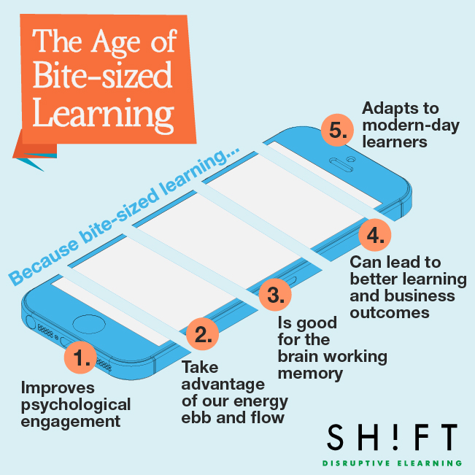

Learning in Byte Size Pieces
Or
Learning Bit By Bit
Security+

